Slide 1

Project Presentation – Group 5
Josue Romain and Kush Halani

Slide 2
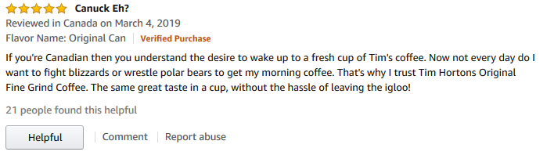
Problem Statement
Supervised learning – Text classification – Sentiment analysis
Reviews of fine foods on Amazon
Input: Review – Output: Rating

Slide 3
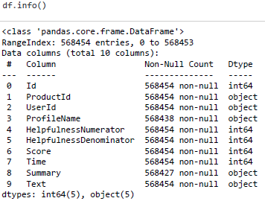
Data

Slide 4
Methodology, Results and Discussion
Data Cleaning and Data Exploration
Feature Engineering
Word2Vec
TF-IDF
Feature Selection – Word Embedding
Model Selection and Model Evaluation
Linear SVC
Random Forest Classifier
Multinomial Naïve Bayes
Logistic Regression
Ensemble Methods
Bagging
Boosting
Adaboost
Stacking
Interpreting Models

Slide 5
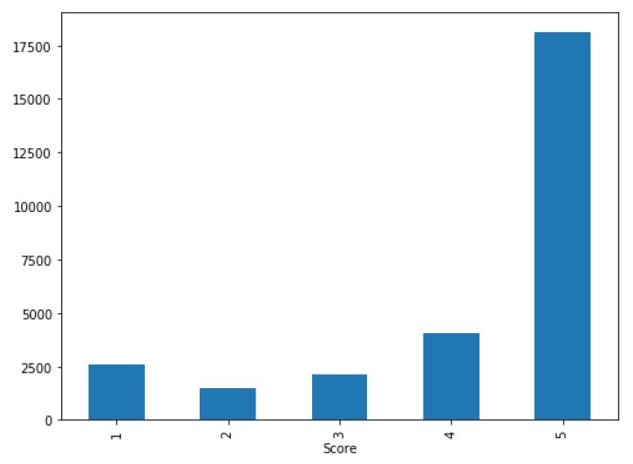
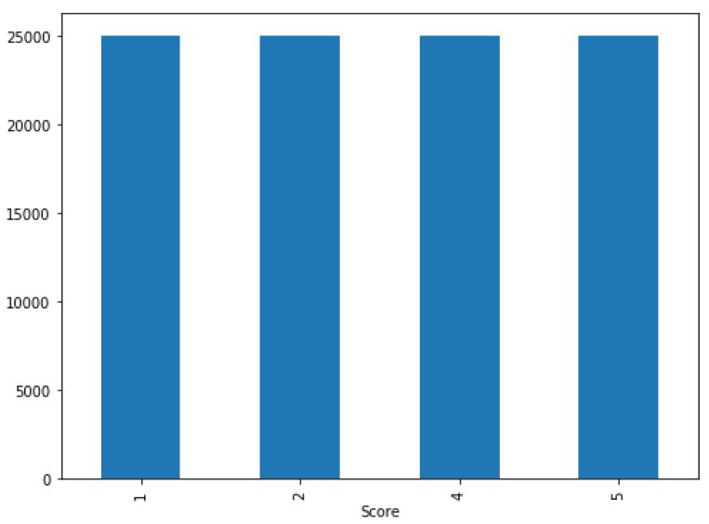
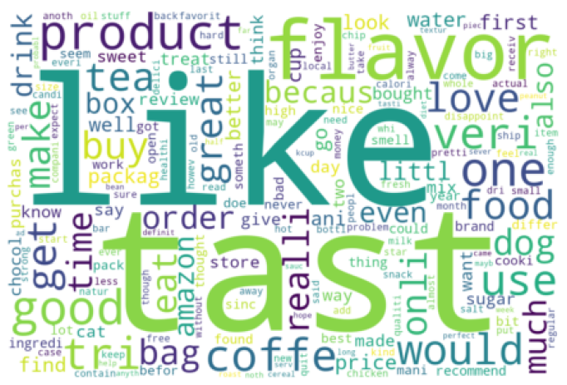
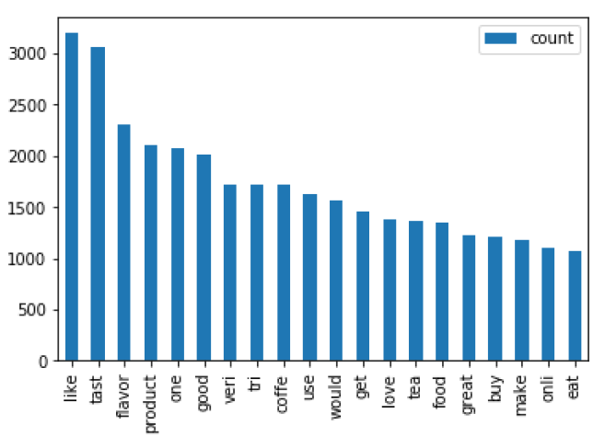
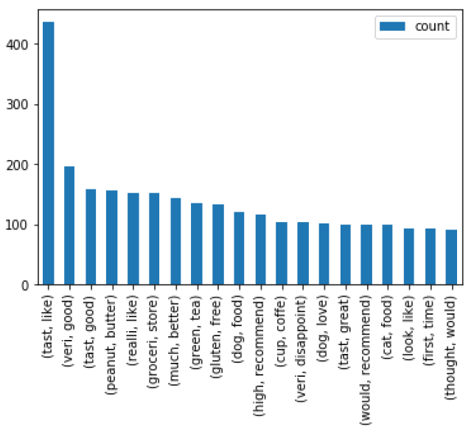
Data Cleaning and Data Exploration
Under Sampling
Removed Stop Words
Removed Special Characters
Stemming
Removed Stop Words using TF-IDF vectoriser

Slide 6
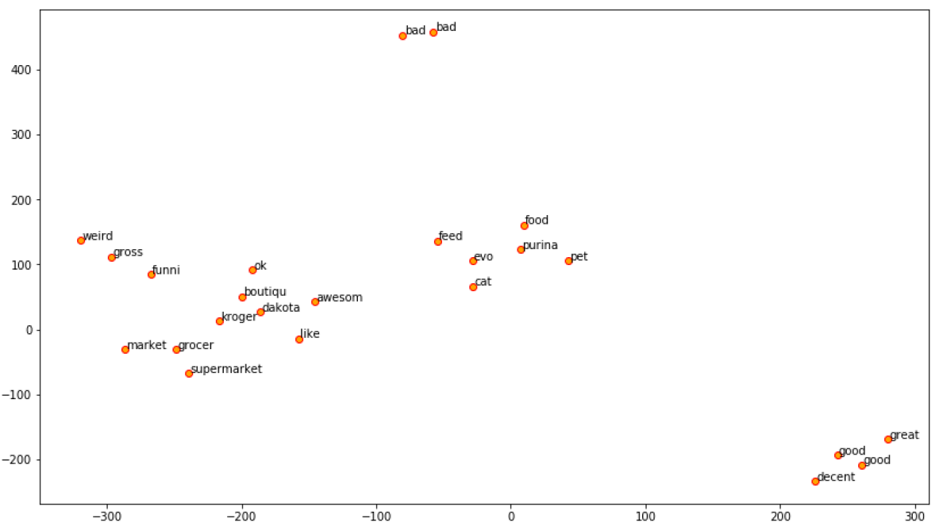
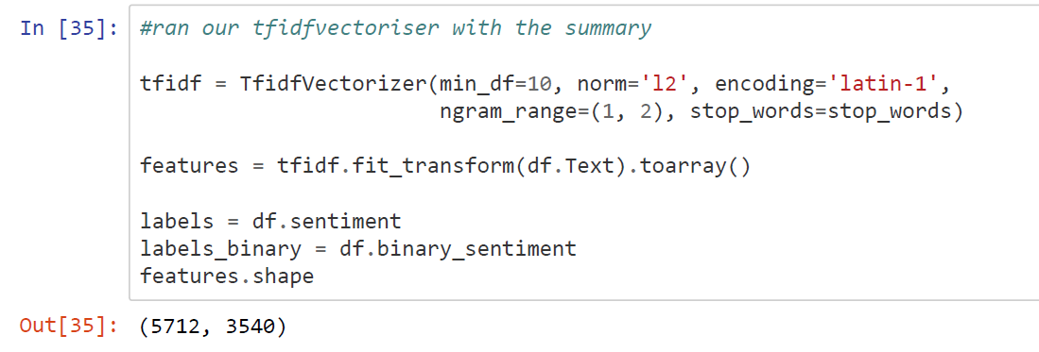
Feature Engineering
Word2Vec
TF-IDF
Notes:
switch

Slide 7
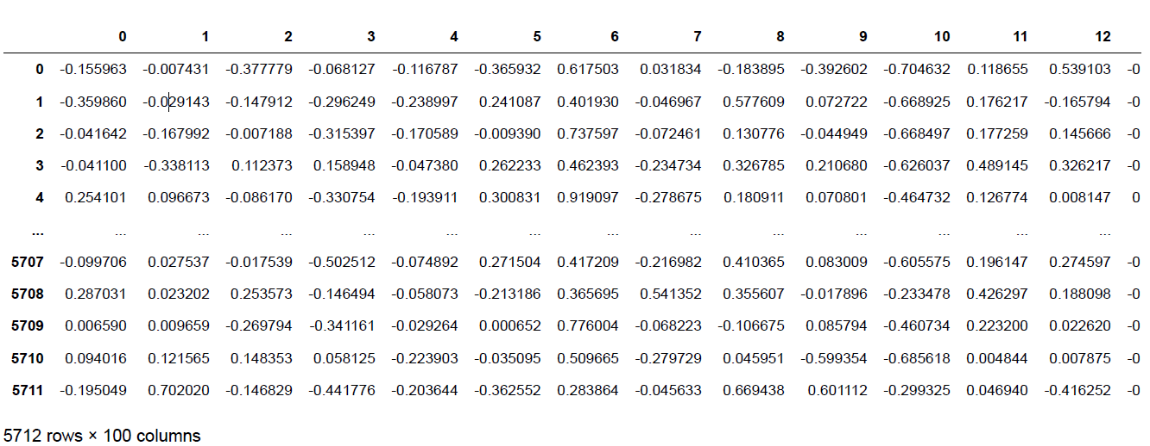
Feature Selection
Word Embedding

Slide 8
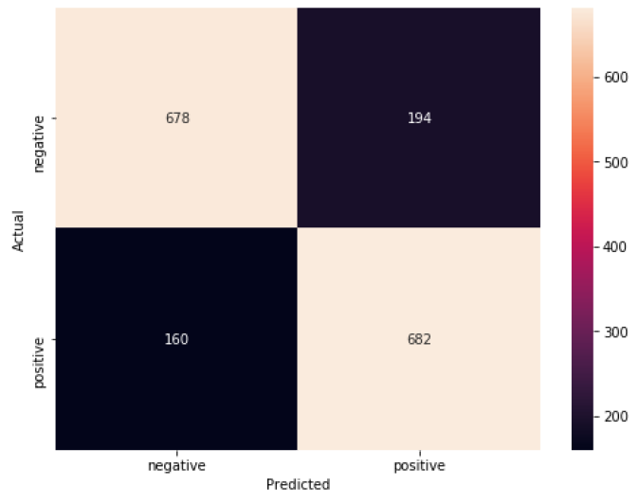
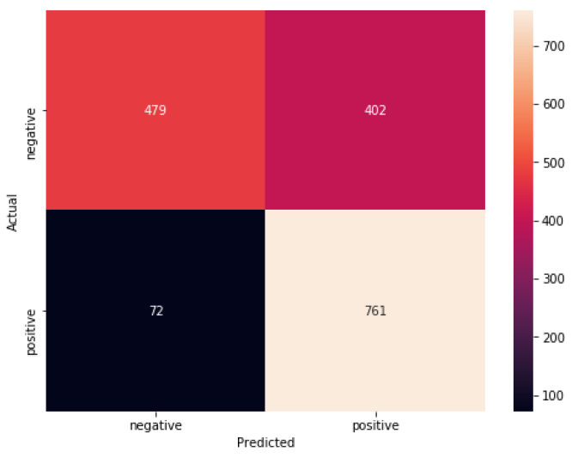
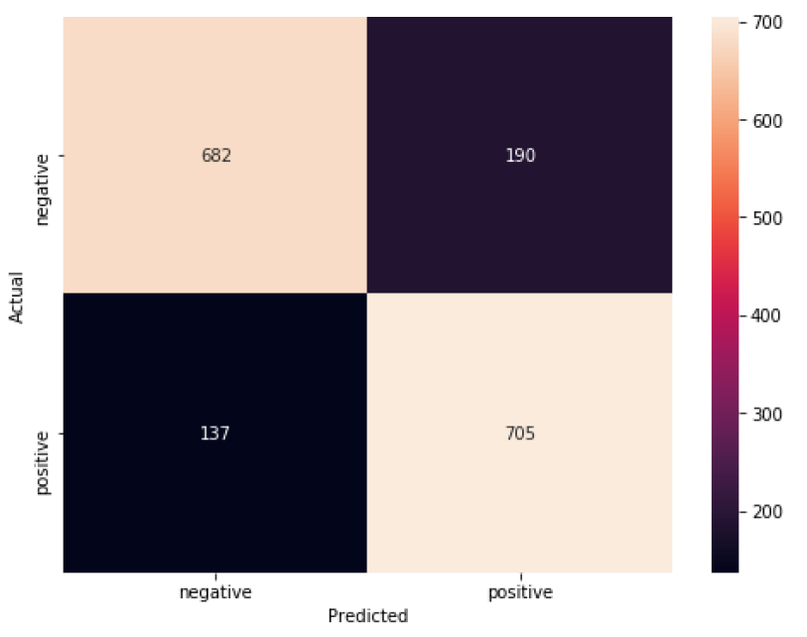
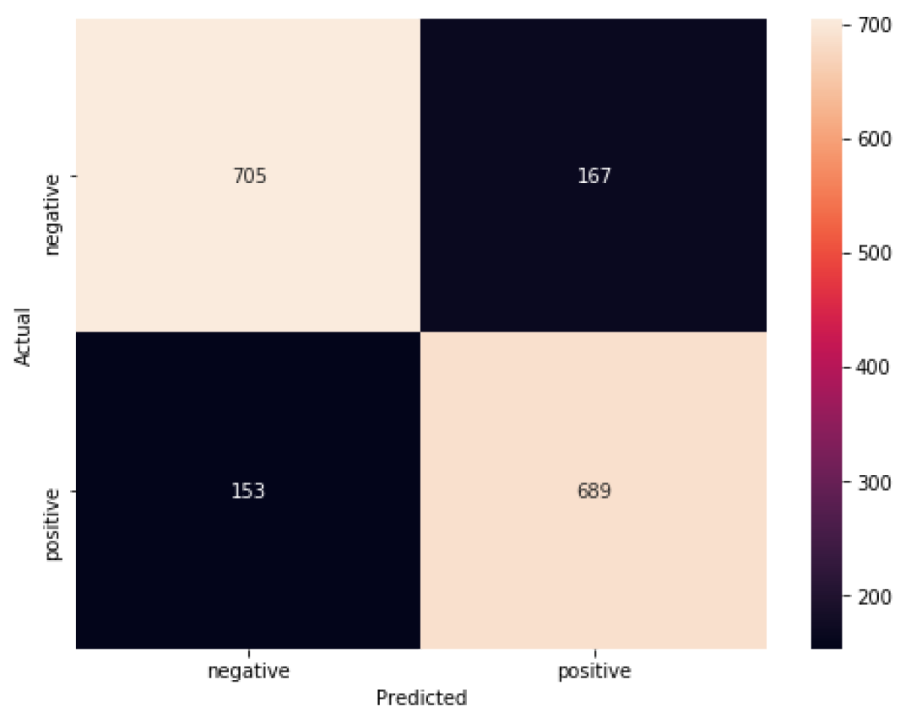
Model Selection (TF-IDF)
Linear Support Vector Classifier
Random Forest Classifier
Naïve Bayes Multinomial
Logistic Regression
Notes:
Confusion Matrix

Slide 9
Model Evaluation
Model Comparison
 | Precision | Recall | F1
Positive | 0.78 | 0.81 | 0.79
Negative | 0.81 | 0.78 | 0.79
Positive | 0.65 | 0.91 | 0.76
Negative | 0.87 | 0.54 | 0.67
Positive | 0.79 | 0.84 | 0.81
Negative | 0.83 | 0.78 | 0.81
Positive | 0.80 | 0.82 | 0.81
Negative | 0.82 | 0.81 | 0.82
Linear SVC
Random Forest Classifier
Multinomial NB
Logistic Regression
 | Accuracy
Linear SVC | 0.79
Random Forest Classifier | 0.72
Multinomial NB | 0.81
Logistic Regression | 0.81
Notes:
Compare all 4 and state which one is the best

Slide 10
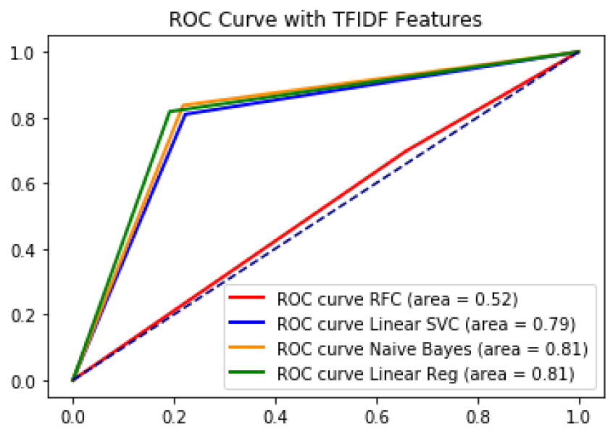
Model Evaluation
(TF-IDF)

Slide 11
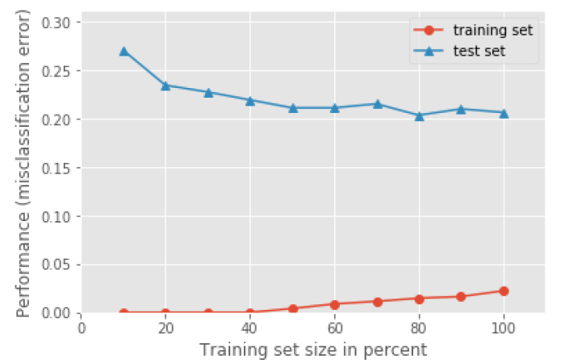
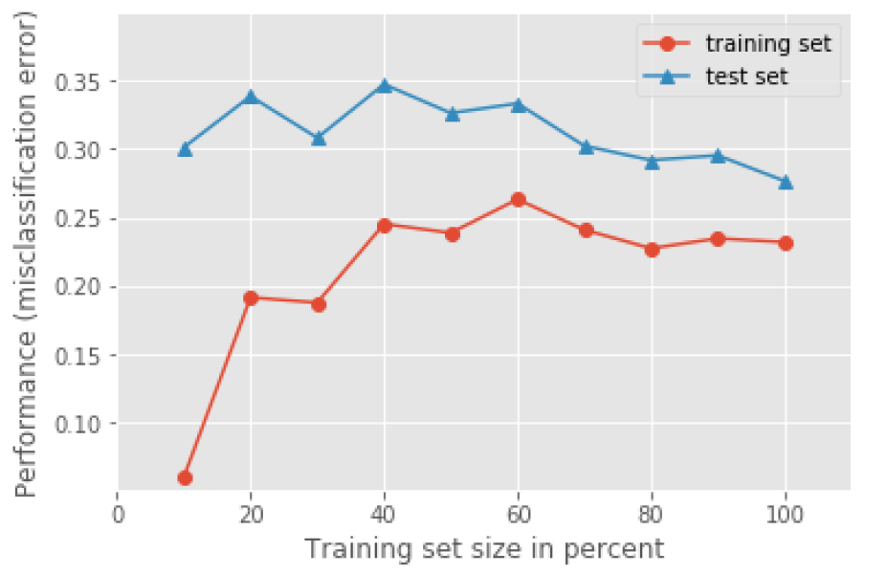
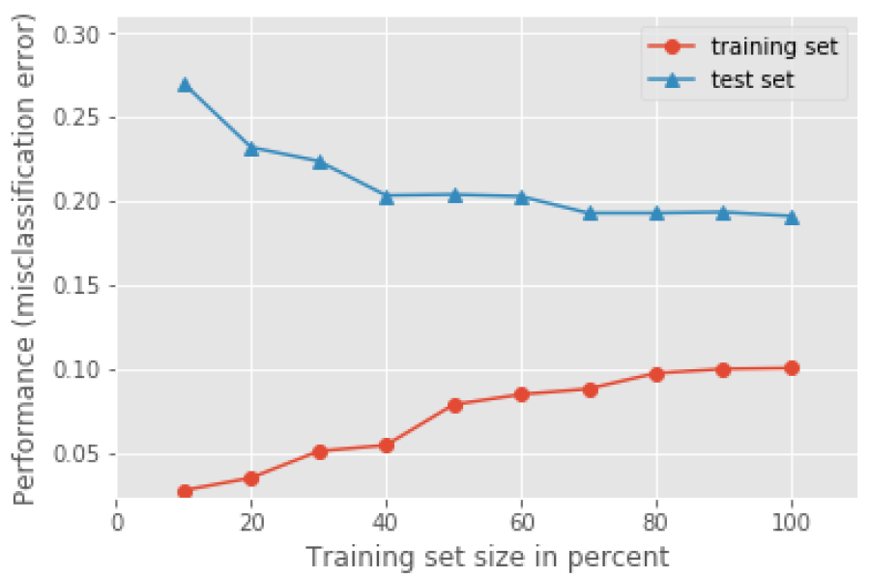
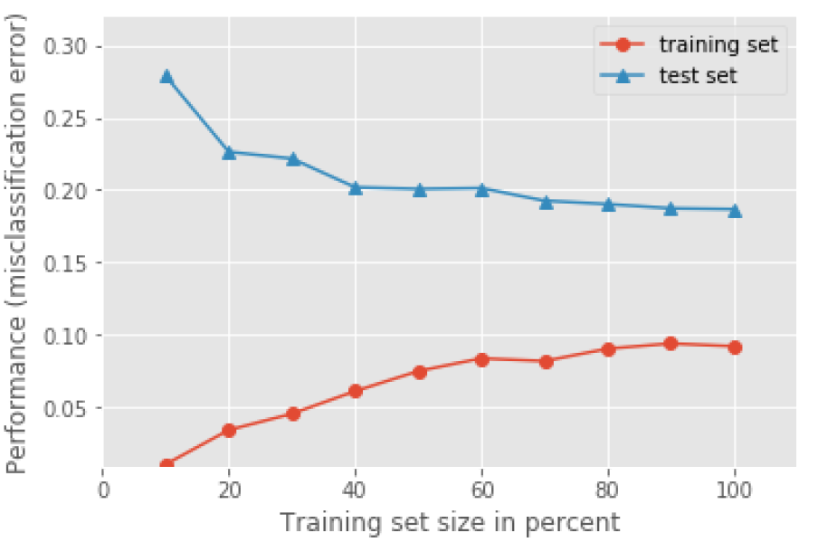
Model Selection
Linear Support Vector Classifier
Random Forest Classifier
Naïve Bayes Multinomial
Logistic Regression
Notes:
switch

Slide 12
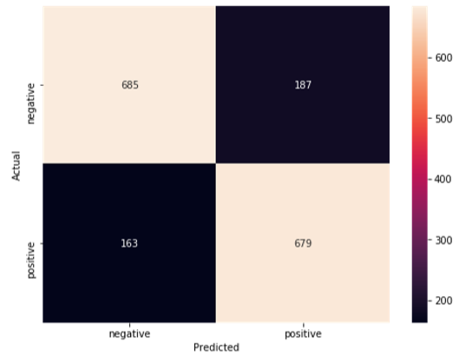
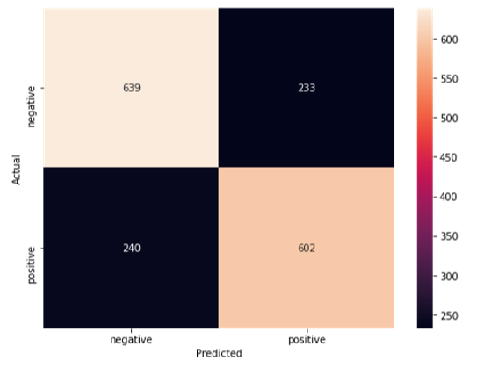
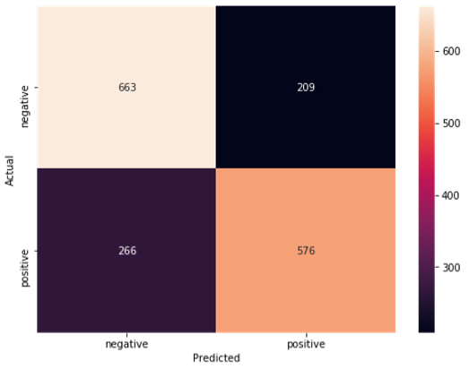
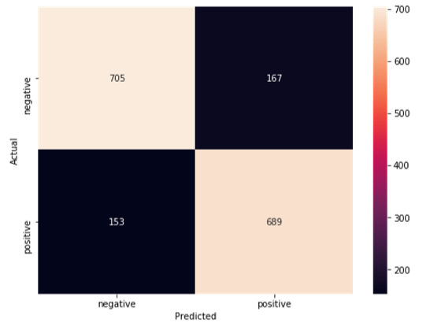
Model Selection (Word2Vec)
Linear Support Vector Classifier
Random Forest Classifier
Gaussian NB
Logistic Regression

Slide 13
Model Evaluation
Model Comparison
 | Precision | Recall | F1
Positive | 0.78 | 0.81 | 0.80
Negative | 0.81 | 0.79 | 0.80
Positive | 0.72 | 0.71 | 0.72
Negative | 0.73 | 0.73 | 0.73
Positive | 0.73 | 0.68 | 0.71
Negative | 0.71 | 0.76 | 0.74
Positive | 0.80 | 0.82 | 0.81
Negative | 0.82 | 0.81 | 0.82
Linear SVC
Random Forest Classifier
Gaussian
Logistic Regression
 | Accuracy
Linear SVC | 0.80
Random Forest Classifier | 0.72
Gaussian | 0.72
Logistic Regression | 0.81
Notes:
Compare all 4 and state which one is the best

Slide 14
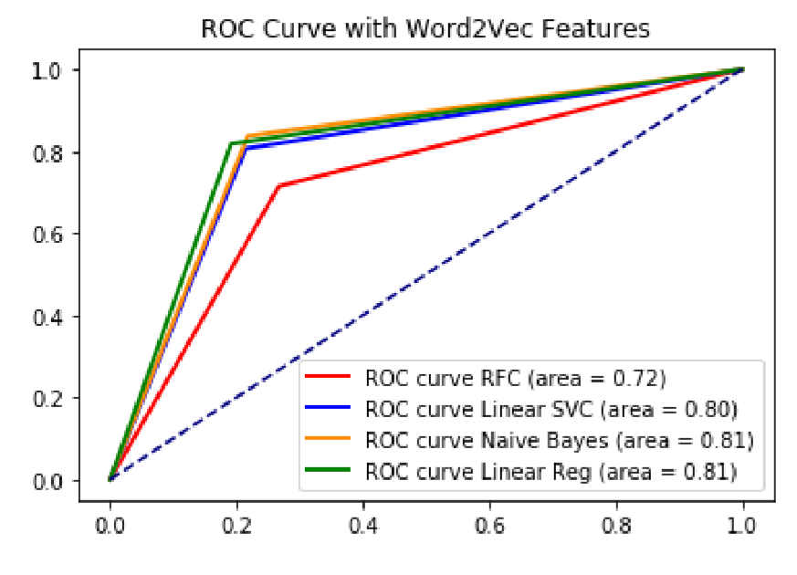
Model Evaluation
(Word2Vec)

Slide 15
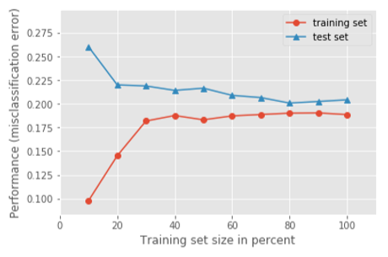
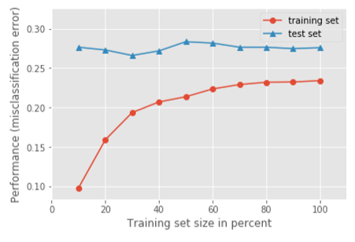
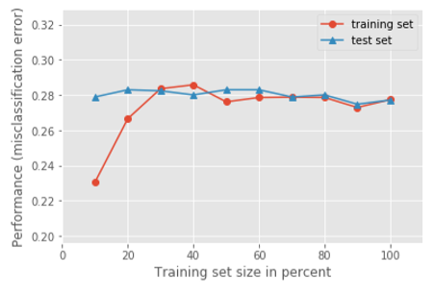
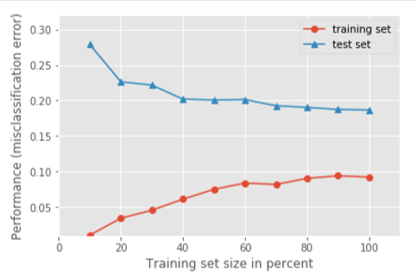
Model Selection
Linear Support Vector Classifier
Random Forest Classifier
Gaussian Naive Bayes
Logistic Regression

Slide 16
TF-IDF
Vs.
Word2Vec
Comparison between Word2Vec and TF-IDF based on performance of models
 | Word2Vec (Accuracy) | TF-IDF (Accracy)
Linear SVC | 0.80 | 0.79
Random Forest Classifier | 0.72 | 0.72
Logistic Regression | 0.81 | 0.81
Notes:
Compare all 4 and state which one is the best

Slide 17
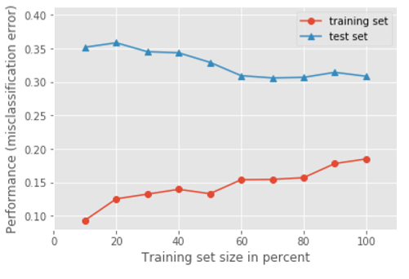
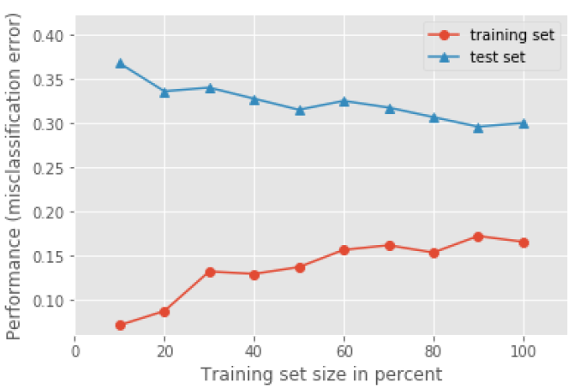
Ensemble Methods
Bagging
Word2Vec
TF-IDF
F1 Score | 0.62 | 0.62
Accuracy | 0.61 | 0.66
F1 Score | 0.79 | 0.62
Accuracy | 0.79 | 0.61
F1 Score | 0.70 | 0.69
Accuracy | 0.71 | 0.70
F1 Score | 0.47 | 0.28
Accuracy | 0.53 | 0.60
Decision Tree
K-NN
Bagging Tree
Bagging K-NN

Slide 18
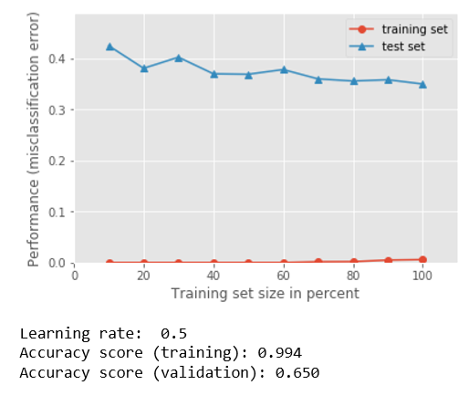
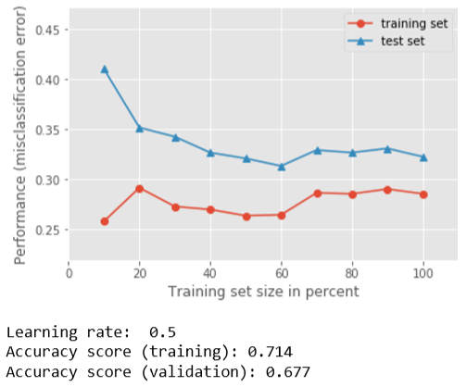
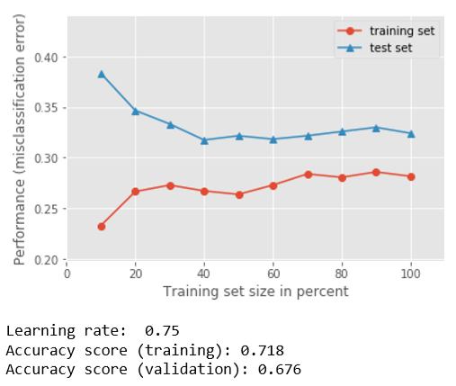
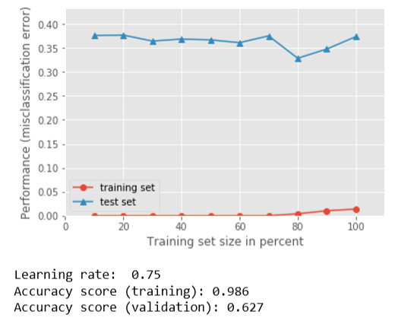
Ensemble Methods
Boosting
Word2Vec
TF-IDF

Slide 19
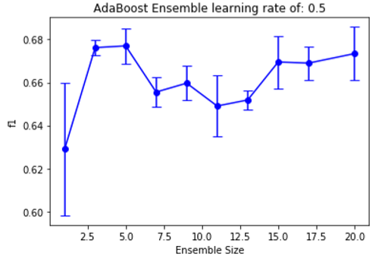
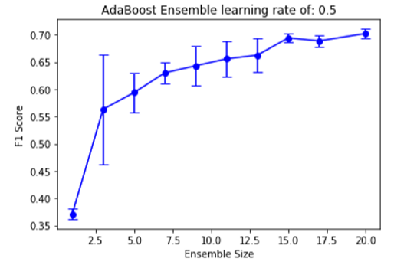
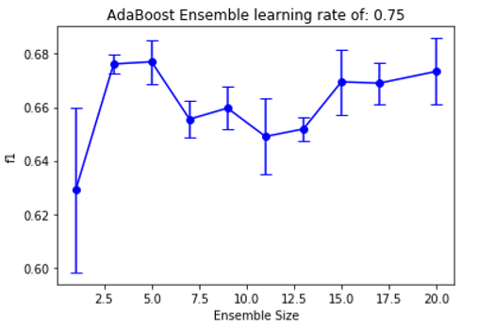
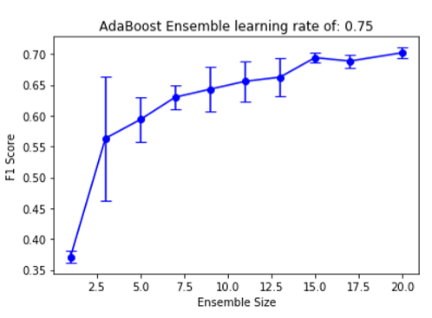
Ensemble Methods
Adaboost
Word2Vec
TF-IDF

Slide 20
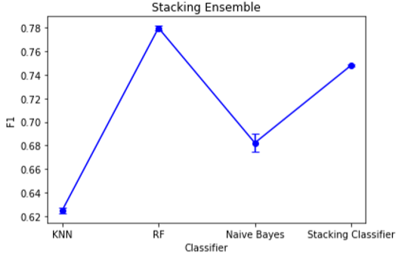
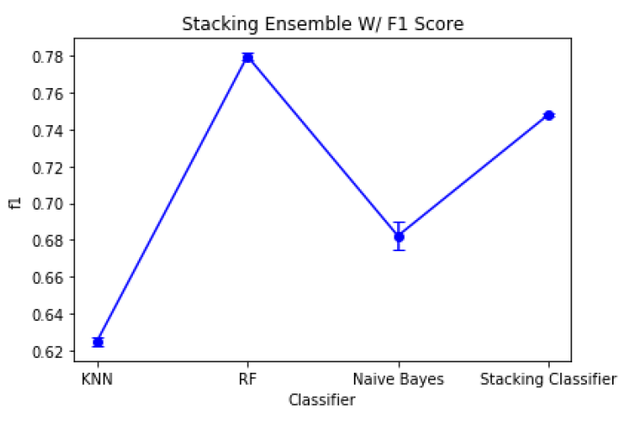
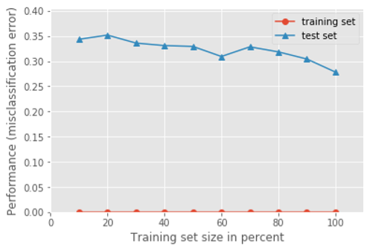
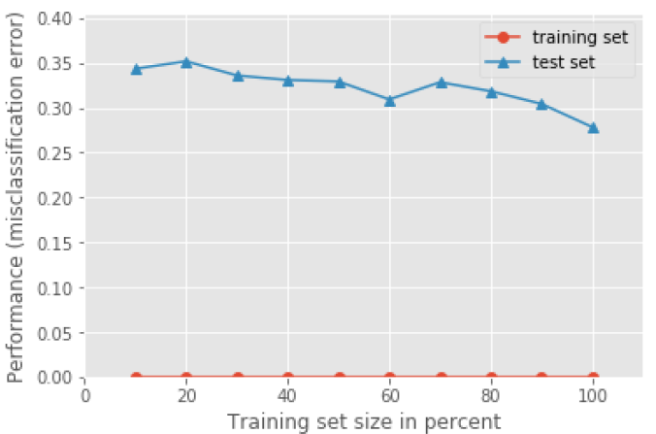
Ensemble Methods
Stacking
Word2Vec
TF-IDF
Notes:
switch

Slide 21
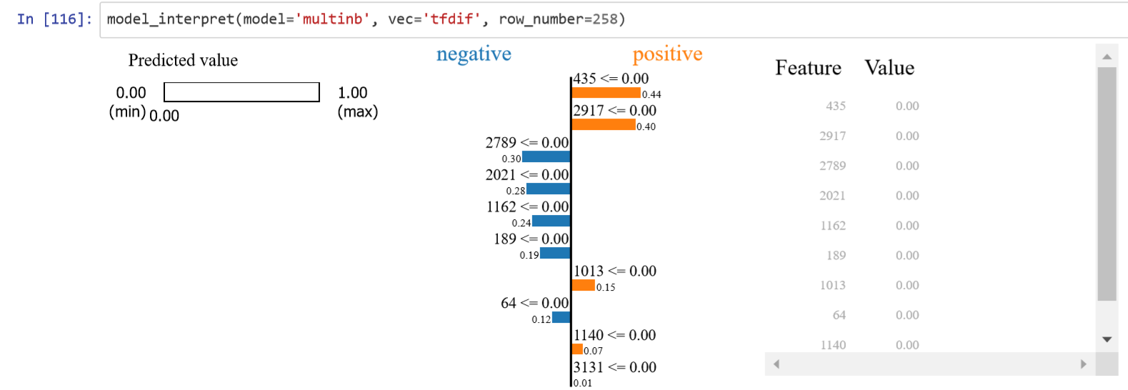
Interpreting
Models
Multinomial NB - TF-IDF

Slide 22
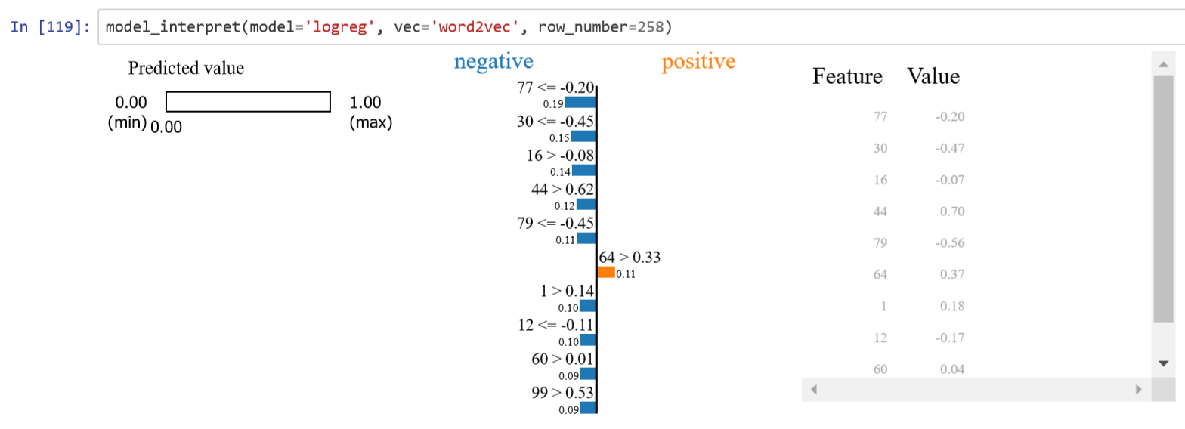
Interpreting
Models
Logistic Regression - Word2Vec

Slide 23
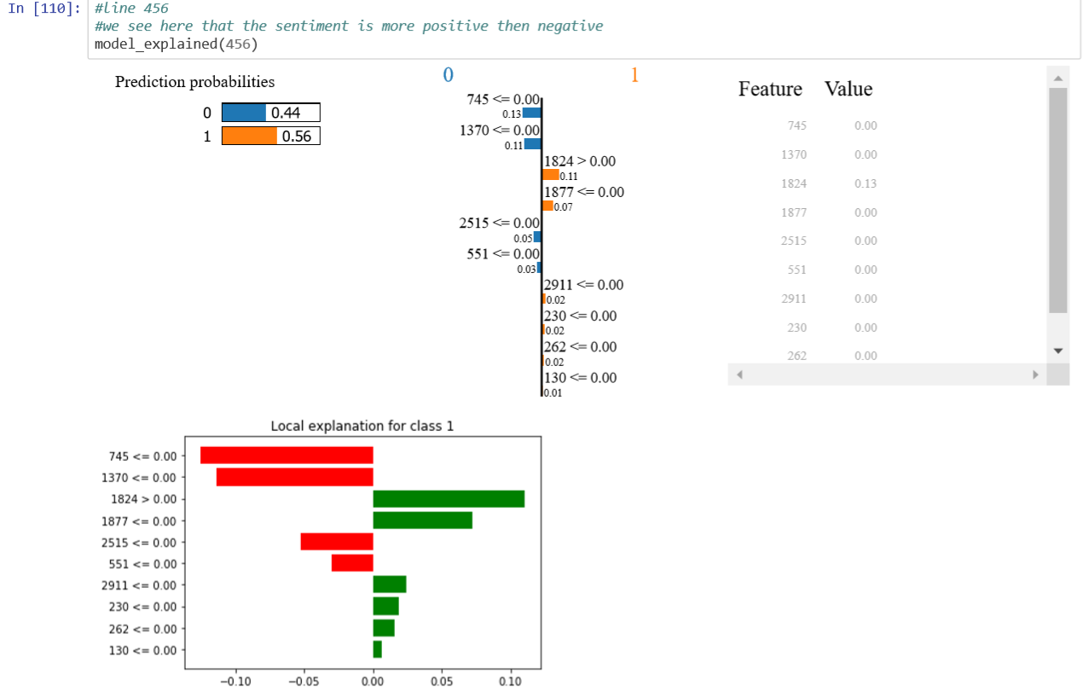
New Model Implemented
Learning using Lime
lightgbm

Slide 24
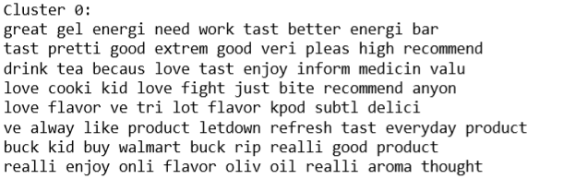
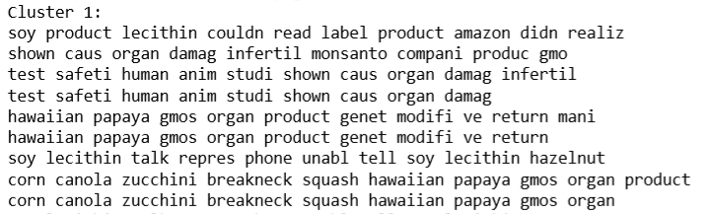
New Model Implemented
Unsupervised Learning
K Means Cluster with TF-IDF

Slide 25

Future Work
Continuous Bag of Words model
Neural Network
Higher Computing Power
Possibly cloud computing
Incorporate Entire Dataset

Slide 26
Conclusion

Slide 27
Thank you

Slide 28
References
https://medium.com/@sabber/classifying-yelp-review-comments-using-lstm-and-word-embeddings-part-1-eb2275e4066b
https://medium.com/sanrusha-consultancy/ensemble-learning-bagging-f9329e07fc22
https://pypi.org/project/scikit-plot/
https://stackabuse.com/gradient-boosting-classifiers-in-python-with-scikit-learn/
https://github.com/criticallycode/programming-tutorials/blob/master/boosting_classifier.py
https://medium.com/@sabber/classifying-yelp-review-comments-using-lstm-and-word-embeddings-part-1-eb2275e4066b
https://towardsdatascience.com/deep-transfer-learning-for-natural-language-processing-text-classification-with-universal-1a2c69e5baa9
https://colah.github.io/posts/2015-08-Understanding-LSTMs/
https://www.analyticsvidhya.com/blog/2018/04/a-comprehensive-guide-to-understand-and-implement-text-classification-in-python/
https://towardsdatascience.com/applying-machine-learning-to-classify-an-unsupervised-text-document-e7bb6265f52
https://towardsdatascience.com/decrypting-your-machine-learning-model-using-lime-5adc035109b5

